Slide 1



Calculator App Presentation

Slide 2

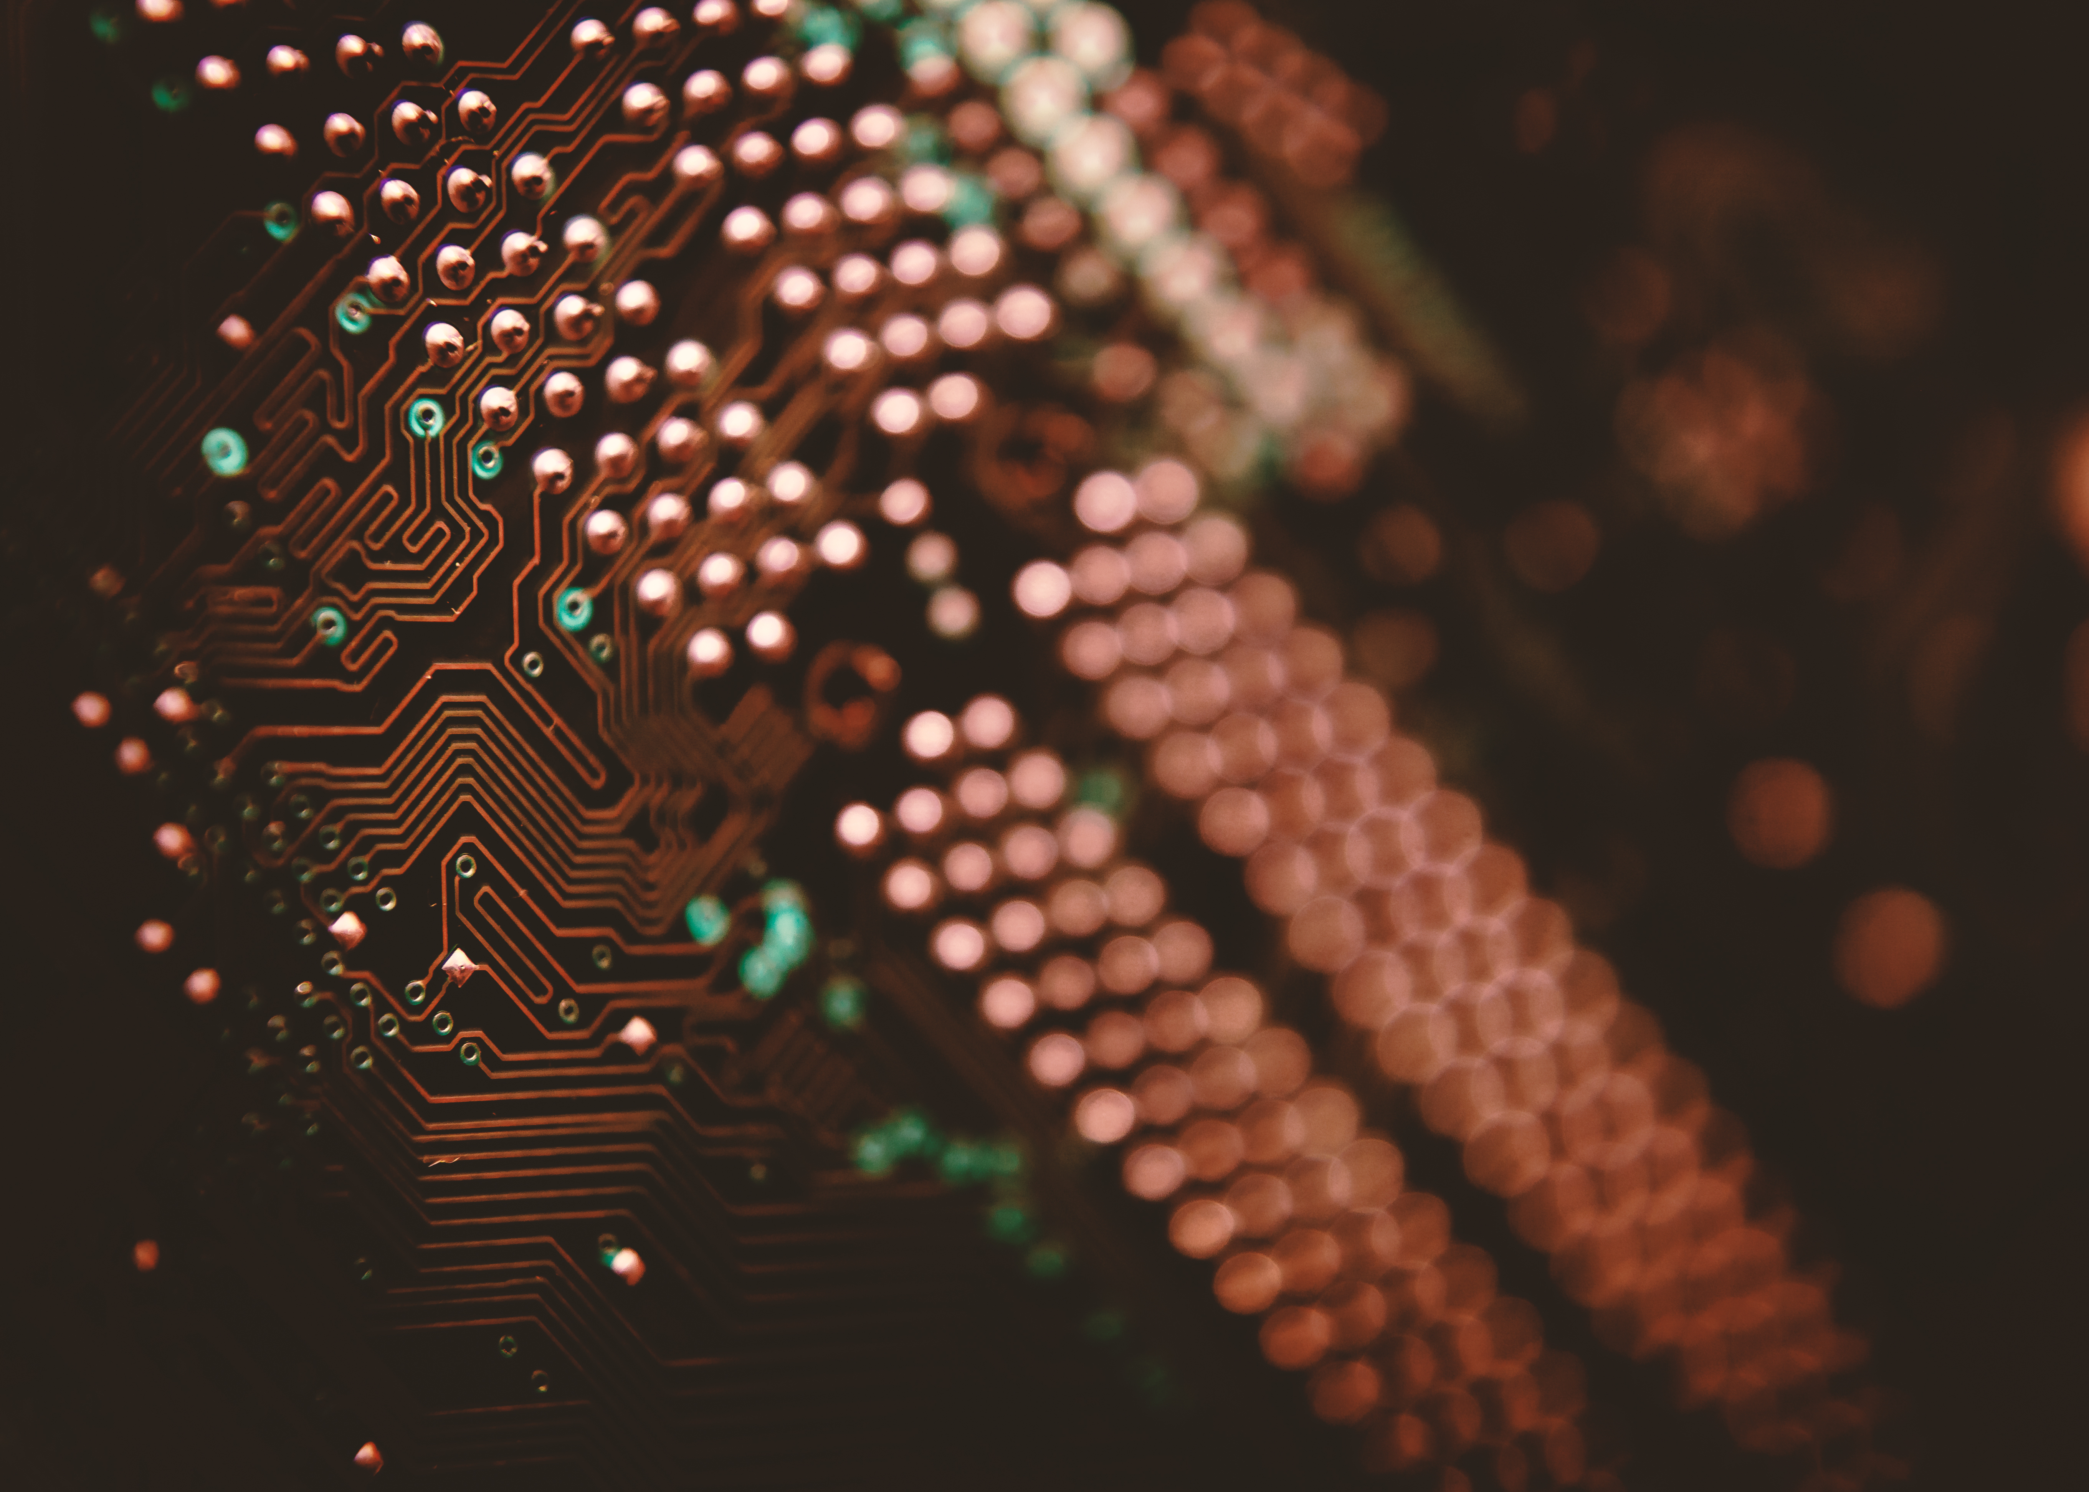

Agenda
GUI
Tkinter
Widgets
Functions

Slide 3

Graphical User Interface
• A Graphical user interface (GUI) is a desktop application that allows users to interact with computers.
• Graphical representations such as buttons and icons are included, and communication can be accomplished by interconnecting with the icons.
• Ex- Microsoft Windows, macOS etc.
• Several Libraries in Python used for GUI -
• Tkinter
• Kivy
• PyQt5
• wxPython
• PyGUI

Slide 4

Tkinter
Tkinter is Python's standard GUI library.
When Python is used in conjunction with Tkinter, creating graphical user interfaces is quick and simple.
It gives the Tk GUI toolkit a sophisticated object-oriented interface.

Slide 5
Tkinter Programming
It's simple to make a GUI application with Tkinter. Steps that have to be follow are –
Importing the tkinter module.
Creating a main window.
Adding multiple widgets in a main window.
Entering into the main event loop to perform action.
When establishing a Python application with GUI, there are two primary approaches that the user has to follow after importing tkinter module –
Tk( ) - It is used to make a main window.
mainloop( ) - It is an infinite loop that runs the application, waits for an event, and processes it as soon as the window is open.

Slide 6
Widgets
Tkinter offers many controls in a GUI application, such as buttons, labels and text boxes. • Widgets are the general name for these controls.
Different types of widgets present in Tkinter are –
• Label
• Button
• Entry
• Checkbutton
• Canvas
• Frame

Slide 7
Geometry configuration of widget
There are primarily three types of geometry manager classes -
pack( ) - It is used to place a widget on top.
grid( ) – It is used to organize the widget in table-like structure.
place( ) – It is used to organize the widget at specific position.

Slide 8
Types of widgets
Label - display box in which image or text is added. Syntax –
Options that can be passesed as arguments –
• bg
• command
• font
• image
• width
• height
l1 = Label (master, opt=val)

Slide 9
Button
It is used to show button in application.
Addition, subtraction, multiplication, and division buttons for basic arithmetic operations.
Clear button to reset the input field.
Decimal point button for floating-point numbers.
Parentheses buttons for grouping expressions.
Syntax –
CheckButton - It is used to show a selection of choices as checkboxes.
Options that can be passesed as arguments -Title ,Bg, activebackground
b1 = Button (master, opt=val)

Slide 10
Frame
It serves as a container and used to organize the widgets-
Syntax-
Options that can be passesed as arguments -
bg
bd
cursor
width
hight
f1 = Frame (master, opt=val)

Slide 11
Usage Instructions
1. Input: Click the number buttons to input digits. Use the operation buttons for mathematical operations.
2. Decimal Point: Click the decimal point button to input floating-point numbers.
3. Parentheses: Use the parentheses buttons to group expressions.
4. Clear: Click the clear button to reset the input field.
5. Calculate: Click the equal button to calculate the result of the expression.

Slide 12
Implementation Details
•The add_to_field function appends the clicked button value to the input field.
•The calculate function evaluates the expression in the input field using the eval function.
•The clear function resets the input field.

Slide 13
Code Structure
•The code uses Tkinter for GUI.
•Global variable field_text stores the expression entered by the user.
•Functions handle button clicks and perform corresponding actions.
•Buttons are created for digits, operations, clear, decimal point, parentheses, and equal sign.

Slide 14
Conclusion
This calculator app provides a simple and intuitive interface for basic arithmetic calculations. It can be extended and customized for more advanced features and functionalities.

Slide 15
